Slide 1


Slide 2
About today…
Object Oriented Programming
Constructors
Inheritance
Abstraction

Slide 3
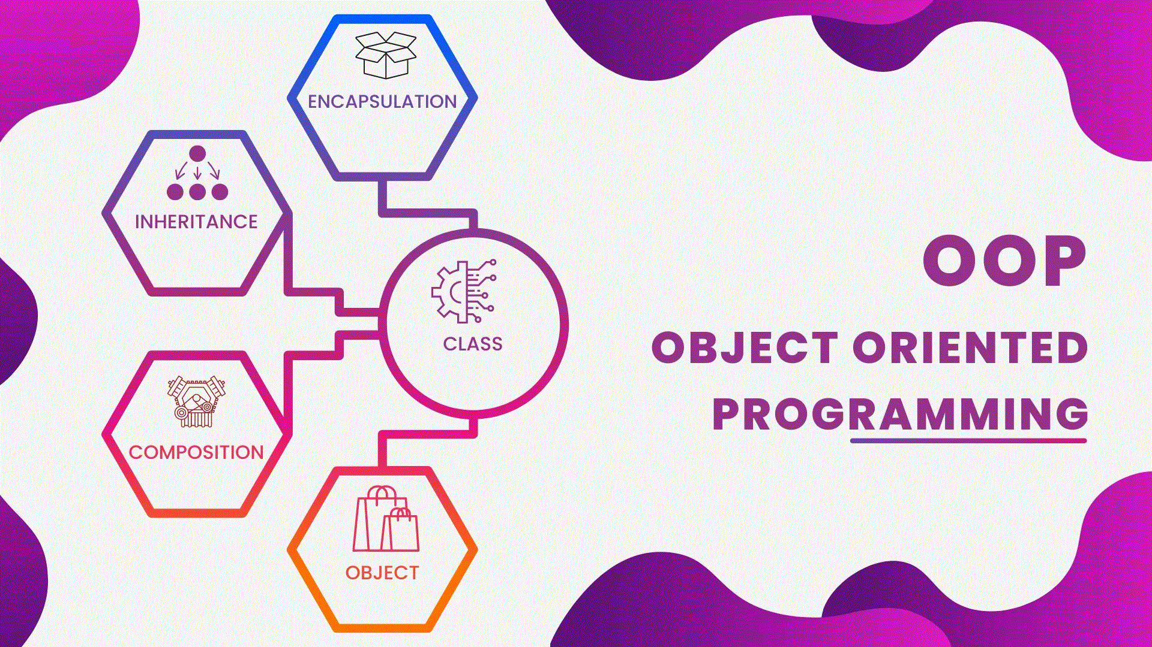

Slide 4

Constructors in PHP
Definition
A constructor is a special method automatically called when an object is created
Purpose
To initialize object properties

Slide 5

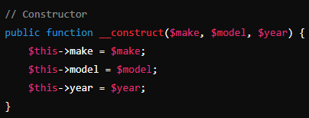


(The __construct method initializes the properties when a new object is created)

Slide 6
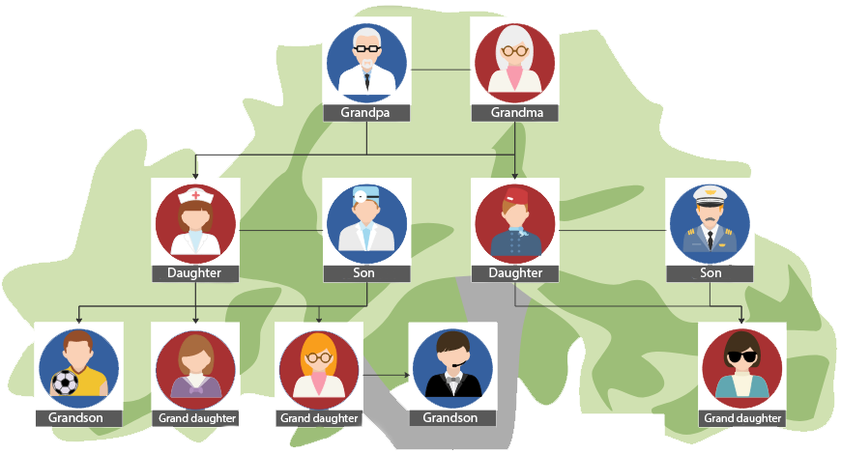
Inheritance in PHP
Definition
Inheritance allows a class to inherit properties and methods from another class
Purpose
Promotes code reusability

Slide 7


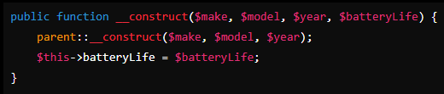

//extends: Indicates inheritance
//Calls the parent class constructor

Slide 8

Abstraction in PHP
Definition
Hiding the complex implementation details and showing only the necessary
features of an object
Purpose
Simplifies the complexity of the system and increases readability and usability

Slide 9
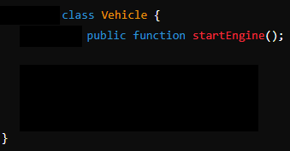

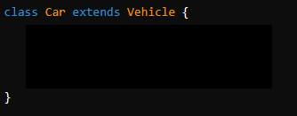


abstract class
A class that cannot be instantiated and is meant to be subclassed
abstract function
A method that must be implemented by subclasses

Slide 10


Slide 11

What is a constructor in PHP?
How do you define a constructor in PHP?
Can a class have more than one constructor in PHP?
Which keyword is used for inheritance in PHP?
What is an abstract class in PHP?
How do you define an abstract class in PHP?

Slide 12

Task 1
Create a class Person with properties name and age, and define a constructor to initialize these properties. Create an instance of the Person class and print the properties.
Task 2
Create an abstract class Shape with an abstract method calculateArea() and a subclass Rectangle that extends Shape. Implement the calculateArea() method in Rectangle, then create an instance and print the area.

